Slide 1
PUZZLING
PYRAMIDS
by Barney Maunder-Taylor
www.houseofmaths.co.uk

Slide 2

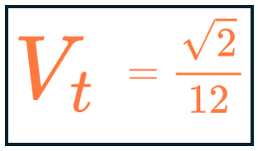
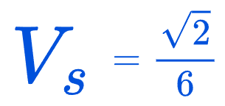

Slide 3
tedious
Trigonometry
:(

Slide 4
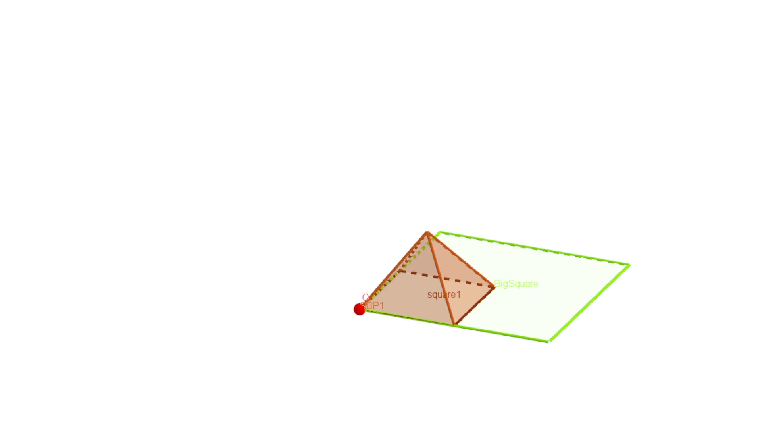

Slide 5
PUZZLING
PYRAMIDS
by Barney Maunder-Taylor
www.houseofmaths.co.uk

